Slide 1
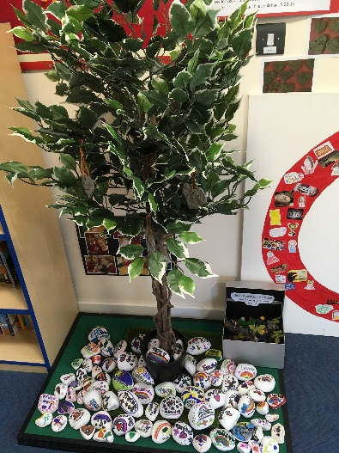
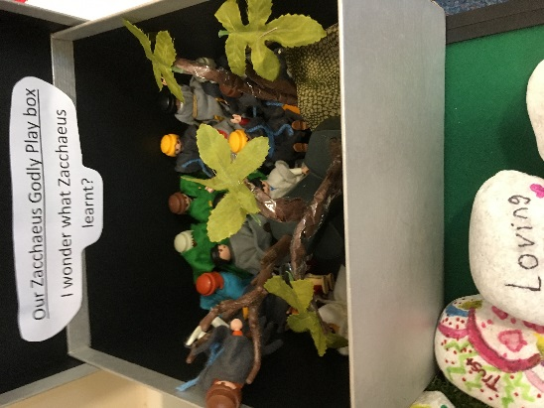
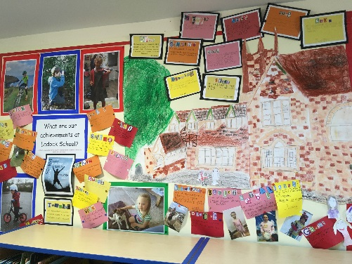
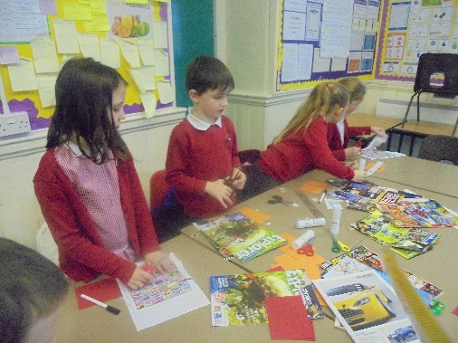
Welcome to our Friday Worship

Slide 2
A pupil is chosen to light the candle and they say:
We light this candle to remind us that we are here to worship God.

Slide 3
Leader says: Please stand up.
Jesus, the Light of the World, is here!
We all say: Lord Jesus, shine upon us.
Leader says: We will now sing our first hymn
(Sit at the end of the hymn)

Slide 4
Leader says: Let us thank God for all the good things in our lives.
Dear God,
Thank you for this amazing world. Remind us to try and look after it. Thank you for our families and friends even though we don’t always show them the respect they deserve. Thank you for helping us to focus and to not be led astray, for making sure we aim as high as we can and reach our goals. Amen

Slide 5
Leader says:
Now let us take this moment to remember those things we have done wrong, to ask God to forgive us and help us to do better

Slide 6
Dear God,
I am sorry for not always thinking before I act;
for getting annoyed and lashing out at people;
for not always respecting others as I should;
for sometimes annoying and upsetting others.
Please forgive me my sins and help me to be compassionate to others.
Amen

Slide 7
Open the Book and Awards

Slide 8
Leader says: Please stand as we say our school creed together.

Slide 9
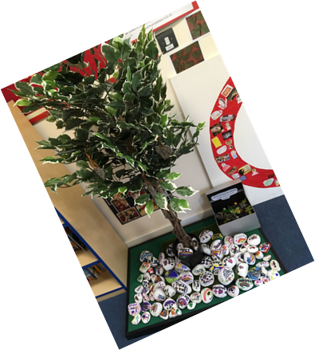
We believe that school should be a place where we can learn and achieve together; where the school values of compassion, respect, trust, truth, perseverance and forgiveness are upheld; where we are loved and where we show love to others and if things go wrong, we can be forgiven; a place where we learn about the Christian faith and how we can live Christian lives.

Slide 10
Leader says: We will now sing our second hymn.
Please sit at the end of the hymn.

Slide 11
Leader says: Let us say together the prayer that Jesus taught us:
Our Father who art in heaven, hallowed be thy name. Thy kingdom come, thy will be done on earth as it is heaven. Give us this day our daily bread and forgive us our trespasses as we forgive those who trespass against us. Lead us not into temptation but deliver us from evil. For thine is the kingdom, the power and the glory forever and ever. Amen

Slide 12
Leader says: We now say our School Prayer together:
Father in Heaven,
May our school be a place filled with love.
May we all learn and achieve together.
Help us to persevere and forgive when things go wrong; to be trustworthy and truthful, compassionate and respectful to all.
Amen

Slide 13
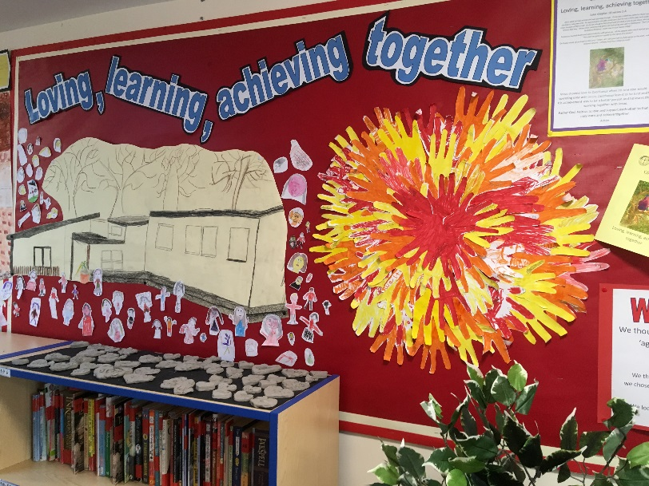
A pupil is chosen to extinguish the candle.
Leader says: Go in peace to love, learn and achieve together.
We all say: In the name of Christ. Amen

Slide 14
Go in peace to love, learn and achieve together.

